Slide 1
Chandidas Mahavidyalaya
Department of Geography
TOPIC: NATURAL VEGETATION OF INDIA
Prof.- Indrajit Mandal

Slide 2
What is natural vegetation?
Natural vegetation is plants that have not been grown by humans. It doesn't need help from humans and gets whatever it needs from its natural environment, that is called natural vegetation.
For example;- Some types of natural vegetation are forests, tundra, grass lands and rainforests.

Slide 3
What are the different types of vegetation found in India?
Major 5 Types of natural vegetation found in India, that are below-
1. Tropical Evergreen Rain Forests.
2. Tropical Deciduous or Monsoon Type Forests.
3. The Thorn Forests and Scrubs.
4. Mountain Forests.
5. Tidal or Mangrove Forests.

Slide 4
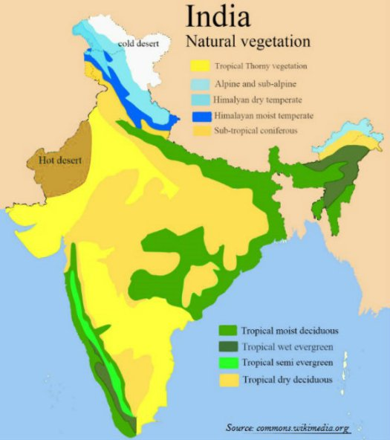

Slide 5
1. Tropical Evergreen Forests:-
The tropical evergreen forests usually occur in areas receiving more than 200 cm of rainfall and having a temperature of 15 to 30 degrees Celsius.
They are found mostly near the equator.This region is warm and wet throughout the year.
Trees reach great heights up to 50 meters or even above.

Slide 6
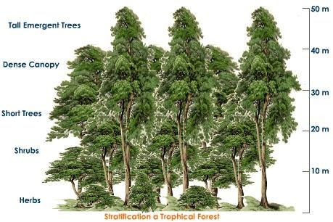
Tropical Evergreen Forests

Slide 7
Place, tree & name of the animals
Place:- In India, evergreen forests are found in the western slopes of the Western Ghats in States such as Kerala and Karnataka. They are also found in hills of Jaintia and Khasi.
Tree:- Some of the trees found in Indian Tropical Forests are rosewood, mahogany and ebony. Bamboos and reeds are also common.
Animal:- Common animals found in these forests are elephants, monkey, lemur and deer.

Slide 8
2. Tropical Deciduous or Monsoon Types Forests
They are the most widespread forests of India.
Also called the monsoon forests and spread over the region receiving rainfall between 200 cm and 70 cm.
Trees of this forest ­type shed their leaves for about six to eight weeks in dry summer.
On the basis of the availability of water, these forests are further divided into a)moist and b)dry deciduous.

Slide 9
a)Moist deciduous forests:
It found in areas receiving rainfall between 200 and 100 cm.
Location: Exist mostly in the eastern part of the country – northeastern states, along the foothills of the Himalayas, Jharkhand, West Orissa and Chhattisgarh, and on the eastern slopes of the Western Ghats.
Trees: Bamboos, sal, shisham, sandalwood, kusum, arjun, mulberry are other commercially important species.

Slide 10
b)Dry Deciduous Forests:
The dry deciduous forests are found in areas having rainfall between 100 cm and 70cm.
Location: These forests are found in the rainier parts of the peninsular plateau and the plains of Bihar and Uttar Pradesh.
Trees: There are open stretches in which Teak, Sal, Peepal, and Neem.
Animales: Common animals found are lion, tiger , pig, deer and elephant. Variety of birds, lizards, snakes, and tortoises are also found here.

Slide 11
3. The Thorn Forests and Scrubs:
In regions with less than 70 cm of rainfall, the natural vegetation consists of thorny trees and bushes.
Location: This types of forest are found in the north­western part of the country including semi­arid areas of Gujarat, Rajasthan, Madhya Pradesh, Chhattisgarh, Uttar Pradesh and Haryana.
Trees are scattered and have long roots penetrating deep into the soil in order to get moisture.

Slide 12
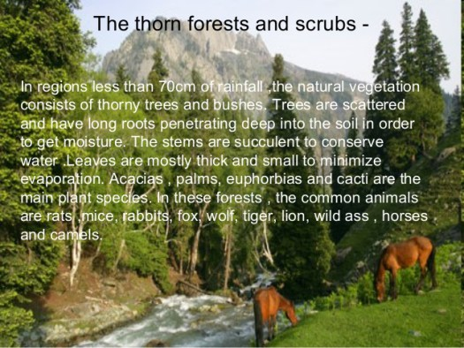

Slide 13
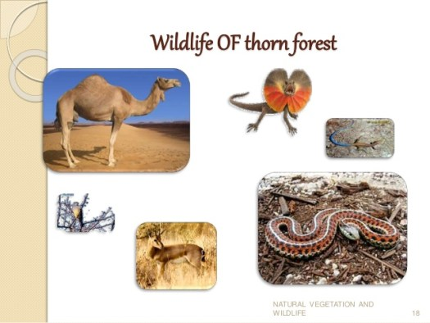

Slide 14
4. Mountain Forests:
In mountainous areas, the decrease in temperature with increasing altitude leads to the corresponding change in natural vegetation.
The wet temperate type of forests are found between a height of 1000 and 2000 meters.
Evergreen broad­leaf trees such as oaks and chestnuts predominate.

Slide 15
Between 1500 and 3000 meters, temperate forests containing coniferous trees like pine, deodar, silver fir and spruce are found. and they cover mostly the southern slopes of the Himalayas, places having high altitude in southern and north­east India.
At higher elevations, temperate grasslands are common.
At high altitudes, generally more than 3,600 meters above sea­ level, temperate forests and grasslands give way to the Alpine vegetation.

Slide 16
Silver fir, junipers, pines and birches are the common trees of these forests.
Common animals found in these forests are Kashmir stag, spotted dear , wild sheep, jack rabbit, yak, snow leopard, squirrels, Shaggy horn wild ibex, bear and rare red panda, sheep and goats with thick hair.

Slide 17
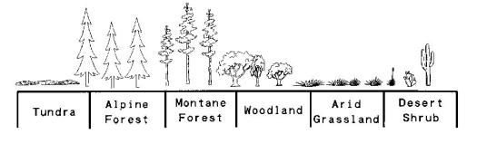

Slide 18
5. Mangrove Forests:
Mangrove forest are found in the areas of coasts influenced by tides.
Mud and silt get accumulated on such coasts.
Dense mangroves are the common varieties with roots of the plants submerged under water.
The deltas of the Ganga, the Mahanadi, the Krishana, the Godavari and the Kaveri are covered by such types of vegetation.

Slide 19
In the Ganga Brahmaputra delta, sundari trees are found, which provide durable hard timber.
Trees: Palm, coconut, keora, agar, also grow in some parts of the delta.
Royal Bengal Tiger is the famous animal in these forests.
Animals: Turtles, crocodiles, deer, wild pigs and snakes are also found in these forests.

Slide 20
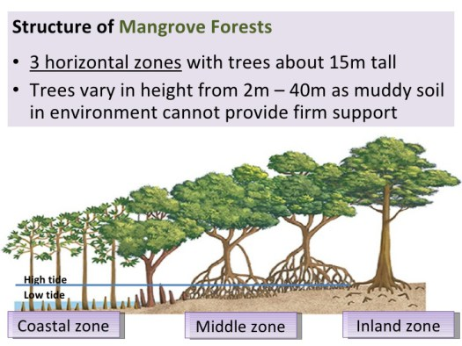

Slide 21
Conclusion:-
However, natural vegetation is the most important part of global environment. So without vegetation we can not live any where. Because vegetation gives us oxygen. For this reasons we can not survives without any vegetation.

Slide 22
THANK
YOU

